Slide 1
Cooker & Canister
Inventory Management
Q2 2020

Slide 2
Objectives

Slide 3

Project objectives & scope
To capture shared principles and goals that will guide Cooker & Canister inventory management across relevant KOKO departments, with initial focus on:
Cooker Manufacturing [Lead: Salil]
Cooker Distribution [Lead: Matt]
Cooker Quality & Service [Lead: Sagun]
Customer Care [Lead: Ari]
Agent Network [Lead: Ari]
Finance [Lead: Nick]
To describe the current processes & tools that are used today and identify gaps and weaknesses
To identify & prioritize key process & tool improvement opportunities
To clarify roles & responsibilities for both improvement design & ongoing process management
Initial scope will be focused exclusively around Cooker Kits (cookers and canisters), though deliverables should serve as a useful template for other future inventory management efforts (eg, Cooker spare parts, KOKO Point parts, etc.)

Slide 4
Guiding principles
An effective inventory management program should adhere to the following principles:
Comprehensive: inventory should be trackable throughout the stock lifecycle with key milestones logged (eg, production, shipment, transit, clearing, QC, distribution, fulfillment, repair, and write off) and across geographies
Detailed: inventory tracking should clearly indicate whether stock is ready or not ready for customer use as well as provide additional information for analysis (eg, “written off due to irreparable fire damage” is better than “written off”)
Well-controlled: movements should be restricted based on role and risk & monitored regularly
Automated: movements should be simple & software-driven where possible to minimize operational burden
In addition, inventory location naming conventions should meet the following criteria:
MECE: locations should create mutually exclusive, collectively exhaustive (MECE)
Detailed: locations should cover all material physical areas and virtual process steps
Action Oriented: Internal inventory locations should drive action for stock that is not yet ready for customers
Intuitive: locations should have clear, simple naming conventions

Slide 5
Baseline
Where are we now?

Slide 6
Baseline | Current software architecture
Warehouses are the largest physical stock-keeping area
Locations are smaller stock-keeping areas that can be placed within Warehouses or elsewhere
There are 3 types of Locations:
Physical: areas of Warehouses that KOKO owns (eg, loading bay, service center, shelves, etc.)
Partner: areas of Warehouses that someone else owns (eg, customers, vendors, or other partners)
Virtual: areas for Products that do not currently reside in a warehouse (eg, lost or in transit)
Products are stock-keeping units (SKUs) (eg, Cooker Kit)
Units are each individual Product (eg, Serial 200028515)
Illustrative KOKO Location Setup
Baba Dogo Main Warehouse
Physical Location:
Loading Bay
Physical Location:
Service Area - Pending
Physical Location:
Shelves - Ready
Physical Location:
Service Area - Ready
Physical Location:
Shelves - Not Ready
Physical Location:
Service Area - Failed QC
Virtual Location:
In Transit to Agent
Virtual Location:
Missing
Virtual Location:
In Transit to BDMW
Virtual Location:
Written Off

Slide 7
Baseline | Current inventory movement operations
There are two main categories of inventory movement operations:
Manufacturing, Shipment, & Initial Delivery to Warehouse: to create & receive new units
Mix of manual & automated processes
Split between KNK ERP & Saarus ERP systems, with some steps off system
Internal Transfers: to move existing units within warehouses or out to agents and customers
Mix of manual & automated processes
Some processes captured on KNK ERP while other steps occur off system

Slide 8
Baseline | Manufacturing, shipment, & delivery to warehouse
Manufacturing, Shipment, & Initial Delivery to Warehouse [KNK ERP, Saarus ERP, off system]
Saarus Team manufactures & QCs new Cooker Kits
Saarus Team scans serials on newly ready Cooker kits to add to Product Tracker
Saarus Team creates Delivery Orders for kits scheduled for shipment to Kenya
Kenya ERP automatically creates a PO, which must be approved to receive units in Kenya warehouse
Warehouse Manager scans each kit received at Premier & reconciles any not captured on PO with Saarus team
Kenya ERP automatically adds newly received kits to Inbound location at Premier MSW
Cooker Kit travels from India to Kenya, clears customs, and transits from ICD to Premier warehouse [currently tracked manually via Dispatch Tracker]
Notes:
India manufacturing and stock data are on a separate ERP: tech@kokonetworks.com; password: tech@123; url: https://prod-erp-india.kokonetworks.com/web

Slide 9
Baseline | Internal transfers
Cooker Sales Flow: Warehouse to Transit to Agent to Customer
Cooker Distribution transfers kit from Inbound to Service Centre for QC upon generation of RMA Code
Cooker Distribution transfers kit from Service Centre to MSW once QC is passed
Cooker Distribution transfers kit from MSW to Loading Bay once delivery is scheduled
Cooker Distribution schedules trips via KOKOmile and kits move automatically to ‘Transit Location’
Agents receive kits in their shop via KOKOmile and inventory automatically transfers to the Shop’s stock location
Customer fulfills cooker kit at KOKO Point and inventory automatically transfers to the ‘Customer’ partner location
There are a number of other common inventory movements, most of which are manual:
Movements within a Warehouse (eg, for assembly & repairs)
Movements from Customer or Agent back to Warehouse (eg, for fire incident analysis & other repairs)
Movements to correct data integrity issues (eg, due to stock take, which is now automated)
Notes:
Right now, they are doing QC while cookers are at the ‘Inbound’ location. RMA = Repair Maintenance Authorisation. It’s too tedious to move 100s of kits one by one. NEED: ability to bulk transfer kits from location to another
Tentatively aim for the 16th.

Slide 10
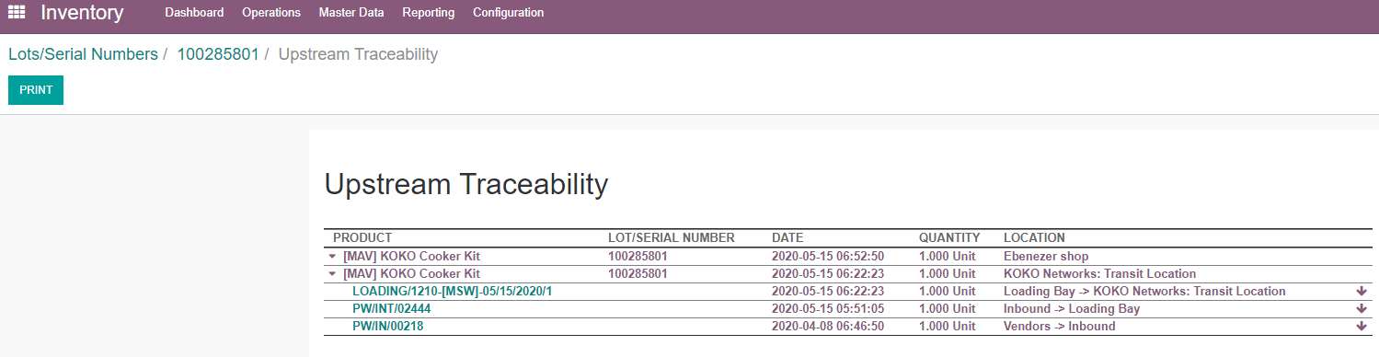
Baseline | Unit-level traceability
Inventory movements for any unit can be tracked on Odoo with time stamps from location to location:
8 April 2020
Received at Premier @ 06:46
15 May 2020
Moved to Loading Bay @ 05:51
Loaded on vehicle @ 06:22
Delivered to Ebenezer Shop @ 06:52
Odoo Process:
Inventory > Master Data > Lots/Serial Numbers > Search for Serial ID > Select Unit > Up/Down Traceability

Slide 11
Baseline | Key documents
Some processes are well documented:
Inventory User Manual
Cooker Kit Received Optimisation
Distribution Operating Processes
Cooker Returns, Repairs, Replacements
Shop Stock Take Process
Other processes (eg, KOKO Mile app scheduling & carrying out of deliveries) are not yet documented. Basic reporting exists with limitations:
Stock Ageing [Tableau]
Stock Levels at Agent Shops [Tableau]
Stock Take Results [Odoo: Fleet > Reporting > Stock Take Results]

Slide 12
Baseline | Current reporting on inventory status
LOCATION | DESCRIPTION | # OF KITS (27 MAY)
Inventory in Agent Possession |  | 3,997
Agent Shops | At KOKO Agent, awaiting fulfillment by customer | 3,997
Inventory in KOKO Possession & Ready for Customers |  | 478
MSW | At Premier Warehouse - QC completed, kit shelved & ready to distribute to Agents | 298
Loading Bay | At Premier Warehouse - Kit ready and waiting to go out for delivery imminently | 172
KOKO Networks: Transit Location | Out for delivery to Agent Shop | 8
Inventory in KOKO Possession & Not Ready for Customers |  | 2,172
Inbound | At Premier Warehouse - awaiting QC | 2,094
Service centre | At Premier Warehouse - undergoing QC | 11
Inventory adjustment | At Premier Warehouse - failed QC and cannot be fixed | 9
Failed QC | At Premier Warehouse - failed QC (and presumably can be fixed?) | 23
RMA unboxing | At Premier Warehouse - stock returned from customers (eg, for replacements) | 13
Sub-assembly | Kits requiring new SmartValves or other spare parts | 1
BDMW | At Baba Dogo Prabhaki Warehouse - Old kits from SmartValve assembly work; need further investigation | 21
Inventory not in KOKO or Agent Possession |  | 321
Missing | Unknown location - pending investigation and possible write off - archived | 0
Vendors | Not intended for cooker stock - artifact of error during SV assembly recordkeeping - fix WIP | 321
Total Kits In Stock |  | 6,968
Initial Observations:
No visibility into stock before arrival at Premier Warehouse
Numbers do not tie 100% with totals manufactured / received / sold in Kenya
Location names are not always intuitive
Locations do not always provide sufficient detail for decision-making (eg, not possible to determine how many cookers need hatch replacements)
Several cookers are at deprecated or wrong locations (eg, Vendors)
Reporting does not currently capture missing units
Source: http://tableau.kokonetworks.com/#/views/Operations-Cookers/StockAgeing

Slide 13
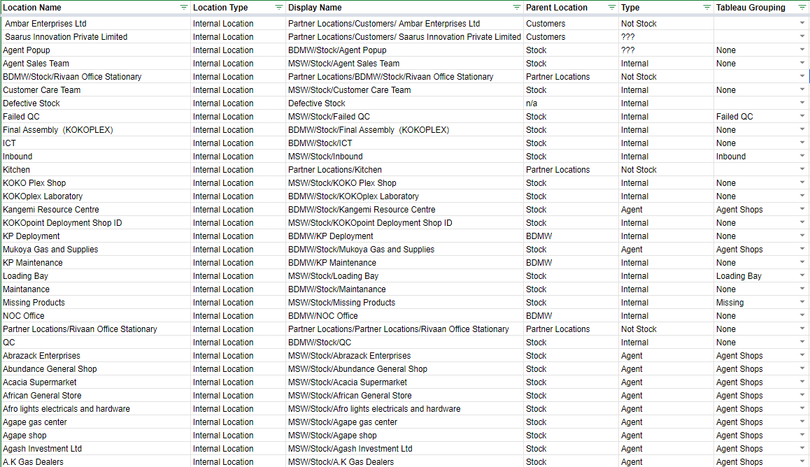
Baseline | Current inventory locations
Odoo Link: https://prod-erp.kokonetworks.com/web#view_type=list&model=stock.location&action=214&menu_id=130
Further Analysis: https://docs.google.com/spreadsheets/d/12YEPd-AEFiOHKk5fnwCc34rkJxzvyKc0cRpe6_l-n7Y/edit#gid=500861239

Slide 14
Baseline | Current inventory management processes
Two core processes are well designed, automated, and implemented:
Receiving new units in Premier Warehouse
Distributing new units to Agent Shops
Many other processes are not fully designed, automated, or implemented:
Manufacturing new units in India & shipping to Kenya (?)
Managing QC for new units in Kenya
Managing cooker reverse logistics & swaps (eg, for fire incident investigations and other customer care)
Managing canister reverse logistics & swaps (eg, for fire incident investigations and other customer care)
Managing repairs of returned units
Reconciling missing stock & writing off lost / damaged stock
Inventory control system is weak:
No process for systematic inventory reconciliation has been implemented
No process for reviewing missing inventory & writing off lost / damaged units has been implemented
Stock Take Feature was released on Tuesday and is now in use during cooker delivery
First week: 763 units targeted across 145 shops with 72 missing (9%) and 26 (3%) in unexpected locations

Slide 15
Path Forward
Problem Statements & Priorities
Process & Timeline
Roles & Responsibilities
Very Next Steps

Slide 16
Path Forward | Focus areas for improvement
1
2
3
4
Location Mapping
Stock Reconciliation
Stock Movement Processes
Management Reporting
Refresh locations
Add missing areas to achieve ensure locations are comprehensive (eg, to capture shipping milestones)
Add areas to enhance decision-making detail (eg, to capture common QC steps)
Clean up duplicates & bad logic (eg, Agents as part of Premier Warehouse)
Map locations to physical space in Premier / Prabhaki
These steps must happen first as foundation for steps #2-4
Run stock take on existing locations
Reconcile missing stock
Identify any additional missing / broken processes
Migrate updated stock levels to newly agreed locations
Continue Agent Shop stock takes as part of weekly cooker deliveries
Iterate on process, as needed
Implement monthly warehouse stock reconciliation
Design missing processes & map to locations / movement requirements
Inbound shipping (?)
Cooker QC
Cooker & Canister swaps
Cooker & Canister repairs
Missing / write off reviews
Improve existing processes
Tighten movement permissions
Scope additional software requirements to support the above
Scope & develop reporting requirements for various audiences
Commercial
Operations
Quality / Engineering
Finance
Implement regular review cadence (eg, monthly business reviews)

Slide 17
Path Forward | Very next steps & high-level plan
Draft proposal for revised inventory locations [Matt]
Confirm additional project participants [All]
Commercial: Allie
Operations: Hezbon, Cedric
Quality: Moses & Maureen
Software: Madhav
Finance: David & Smit
Review and sign off on proposal for new locations [Participants as per above]
Conduct stock take & reconciliation of cookers & canisters at existing locations [Matt + Nick]
Transfer updated (post-stock take) stock to newly agreed locations [Matt, Micael]
Begin process design for key movement operations [Matt, Ari, Micael]
Scope software & analytics requirements for future reporting [Matt, Sagun, Micael, Nick]

Slide 18
Matt Schiller

